Slide 1

Did you know?
Over 700,000 pounds of food is distributed each week to food dependent individuals through food pantries, schools, churches and nonprofit partners

Slide 2
Second Harvest Food Bank

Slide 3

Client Concerns:
Inventory challenges caused by perishability
Order processing errors
Government food waste

Slide 4
Project Objective
To create a predictive model that will:
Provide insight for upcoming sales amounts for customer orders
Determine the most significant features when predicting the sales amount
Will a customer place an order for the most significant feature that drives sales amount?

Slide 5
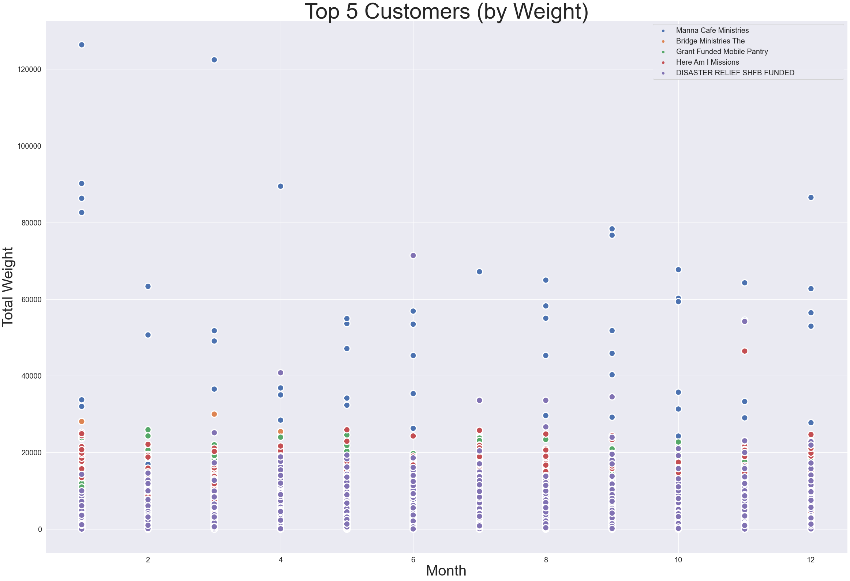

Slide 6
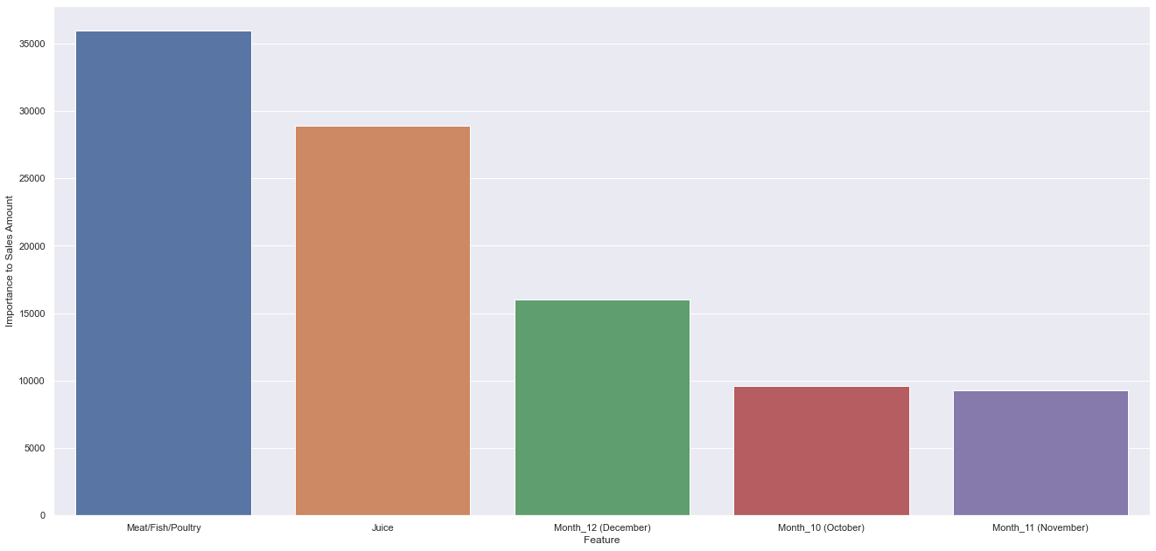
Most Significant Features driving Sales Amount

Slide 7
How does this help Second Harvest?
Predicting sales amount can:
help prepare inventory space
assist with staffing requirements
appropriate limits to customer orders
Long Term Approach : concept can be applied to vendor donations

Slide 8

Questions

